Slide 1


Growth in Toronto
Looking at novel ways to predict property prices

Slide 2
Introduction
Toronto has seen a tremendous increase in property prices between 2014 - 2019, with some neighbourhoods increasing in value by as much as 142\% on average. With immigration only set to increase in the future it can be expected that there will be sustained demand for properties in cities like Toronto and other neighbourhoods will see increases in their property prices when th will lead to increased further increases .A novel way to determine the demand of an area is to find what type of neighbourhoods are the most sort after and finding similar neighbourhoods based on amenities.

Slide 3
Data source
Neighborhood venue category data - Source: Foursquare and web scraping
Neighborhood price increases, both in Canadian dollar terms and percentage increases
- web scraped from Toronto Estate board

Slide 4
Data Cleaning
Data scraped from multiple websites
Initially stored as lists
Merged into data frames using pandas
Fuzzy logic used to match the two data sources to account for potential errors in spelling and different case

Slide 5
Feature Selection
Venue categories taken from foursquare are combined and the most common values are listed in columns ranging from 1st most common to 10th most common. This was done to explore what type of neighborhoods were present and to look for trends
Venue categories also with relative frequency of venue state as this is a more machine ridable format, making it easier for machine learning purposes.
Momentum growth was calculated by adding different growth periods together but weighing more recent growth more heavily so that it is taken more into account.
House prices were calsulated from the dollar term and percentage increases.

Slide 6

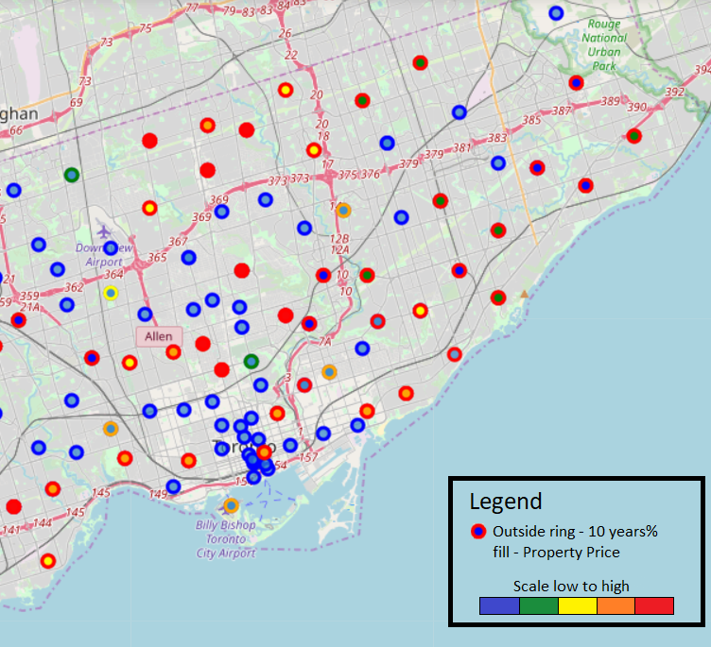
Data exploration
From analysing the data it appeared that location played a large role in what type of neighbourhood was saw the highest growth. These were:
- Mid priced neighbourhoods
- Coastal Neighbourhoods
- Out of city center

Slide 7
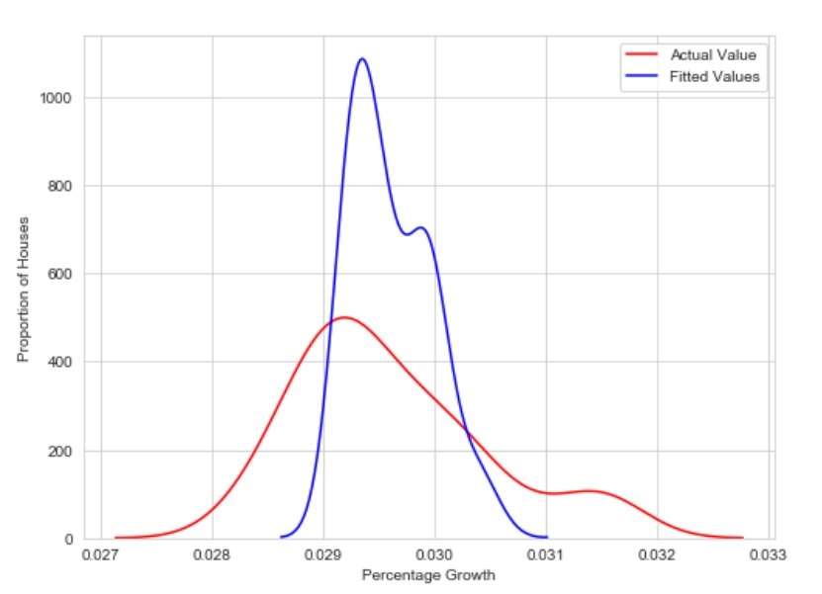
Model Development

Slide 8
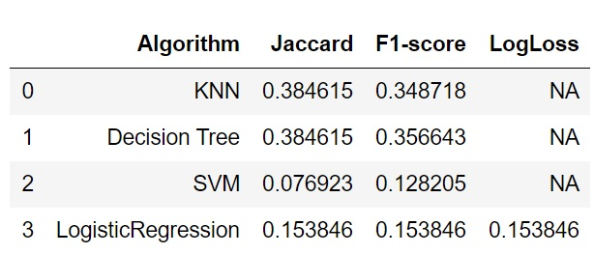
Results
Linear and non-linear regression models saw low prediction accuracy
Classification models venue categories also had low prediction classification prediction scores.

Slide 9
Discussion
numerous insights which could be used by prospective homeowners to help make informed decisions
Neighborhoods in the mid-range can be expected to have the best growth
closer to the coast saw larger growth to similarly priced neighborhoods further from the coast or in the old town
Unfortunately, using venue types is not a very accurate way to predict property growth

Slide 10
Conclusion
The results show that it is difficult to predict growth from venue types using machine learning approaches of a decision tree, SVM, KNN, linear and non-linear regression. There has been some insight gained into the type of properties that are in demand in Toronto such as the desired price range and geographical location. Using a Neural Network approach may help better find trends in the venue category data but it appears that more data about other attributes of the neighbourhoods are required to make accurate assessments of the growth.

